Slide 1


europeana Awareness Evaluation and Tracking Study
Norway – Wave 2
For
Eleanor Kenny, Head of Communications, British Library
By
Simon McDonald, Business Director, InSites Consulting
simon@insites-consulting.com
Frederico Goncalves, Research Consultant FMCG, InSites Consulting
Email Frederico@insites-consulting.com

Slide 2

BACKGROUND & OBJECTIVES OVERVIEW
METHOD, SAMPLE, WEIGHTING
AWARENESS, USAGE & ATTITUDES
SITE ACTIVATION
AREAS FOR IMPROVEMENT
Q & A
APPENDIX

Slide 3
BACKGROUND & OBJECTIVES OVERVIEW
METHOD, SAMPLE, WEIGHTING
AWARENESS, USAGE & ATTITUDES
SITE ACTIVATION
AREAS FOR IMPROVEMENT
Q & A
APPENDIX

Slide 4
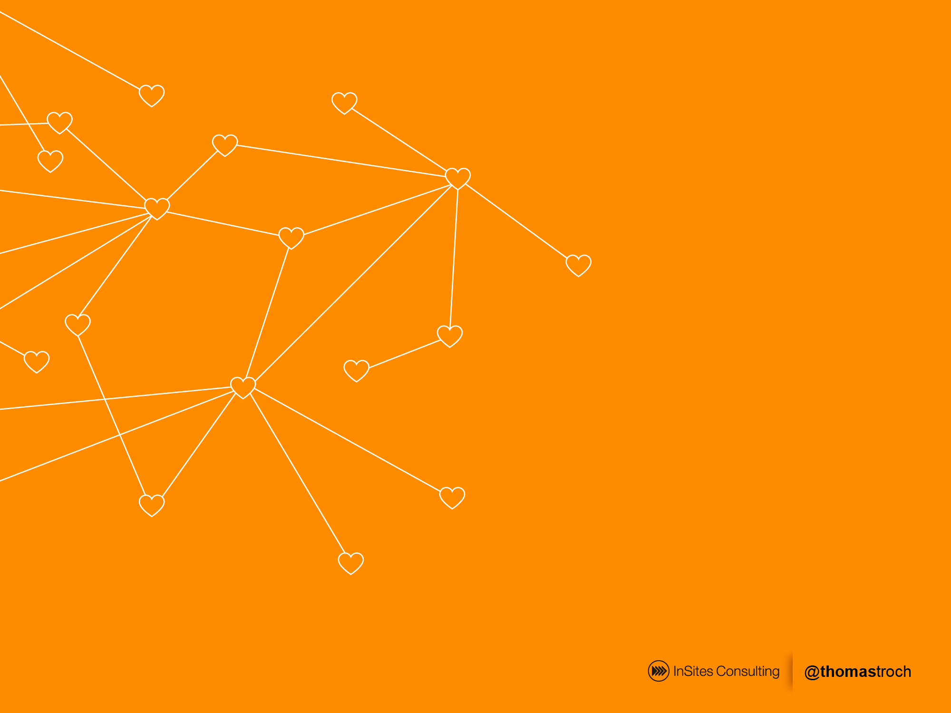

Wave one dipstick to measure awareness, usage, recommendation and attitudes to europeana prior to marketing campaigns
Wave one
Poland
Italy
Norway
500 completed interviews in each market, March 2013
Quantitative
Wave two
Online
Italy – May 2013
Norway
Poland – June 2013
Survey
500 interviews in Norway, June 2014
Wave two to measure changes in awareness, usage, recommendation and attitudes to europeana marketing activity
BACKGROUND & OBJECTIVES OVERVIEW

Slide 5
Quantitative Study
Awareness and Usage
Screening
Activation
Screened for:
Interest in arts/culture/history
Visited museums, exhibitions, libraries, events in last six months
Awareness and usage of europeana and competitive set
Likelihood to visit again and recommend
Source of awareness
Attitudes to europeana
PLUS interest & awareness of the specific campaign
All respondents directed to europeana and asked:
Attitude statements
Likelihood of returning/recommending
Likes/dislikes/suggestions
BACKGROUND & OBJECTIVES OVERVIEW

Slide 6
BACKGROUND & OBJECTIVES OVERVIEW
METHOD, SAMPLE, WEIGHTING
AWARENESS, USAGE & ATTITUDES
SITE ACTIVATION
AREAS FOR IMPROVEMENT
Q & A
APPENDIX

Slide 7
Sample - Screening
All respondents had to have:
Interest in arts/culture/history
Visited museums, exhibitions, libraries, events in last six months
 | Unweighted screened sample W1 | Unweighted screened sample W2
Italy | 516 | 510
Norway | 505 | 502
Poland | 530 | 558
Total | 1,551 | 1,570
All respondents weighted by age and gender within country (W1 and 2)
METHOD, SAMPLE, WEIGHTING

Slide 8
Sample - Weighting
Sample - Weighting
 | Unweighted screened sample | Weighted and grossed
Italy | 510 (32.5%) | 24.3m (52.9%)
Norway | 502 (31.9%) | 1.5m (3.3%)
Poland | 558 (35.6%) | 20.1m (43.8%)
Total | 1,569 respondents | 45.9m people
METHOD, SAMPLE, WEIGHTING

Slide 9
BACKGROUND & OBJECTIVES OVERVIEW
METHOD, SAMPLE, WEIGHTING
AWARENESS, USAGE & ATTITUDES
SITE ACTIVATION
AREAS FOR IMPROVEMENT
Q & A
APPENDIX

Slide 10
Overall Awareness of europeana was low (wave 1)
Only 9% of all respondents are aware of europeana
12%
Italy
10%
Italy (W2)
4%
Norway
6%
Poland
14%
Poland (W2)
AWARENESS, USAGE & ATTITUDES

Slide 11
Overall Awareness of europeana - Norway
But awareness in Norway has increased in the second wave
4%
Norway (wave 1)
7%
Norway (wave 2)
AWARENESS, USAGE & ATTITUDES

Slide 12
Where has awareness changed?
Increase in awareness occurs amongst those:
Working in the culture and education sectors
Very interested in the arts
Less than 35 yos
Wave 2
Wave 1
Less than 35 yo
More than 35 yo
Culture / Education Professionals
Very interested in the arts
Quite interested in the arts
AWARENESS, USAGE & ATTITUDES

Slide 13
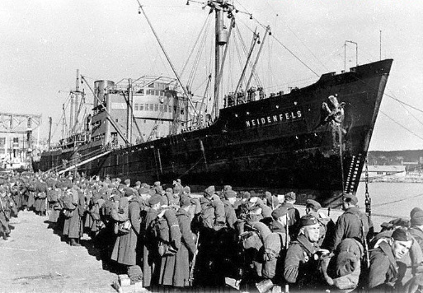
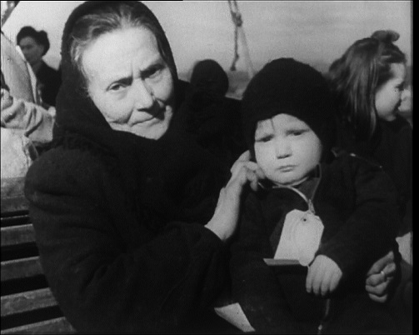
Norway’s untold stories from the Second World War
Interest on the topic and Awareness of europeana related events
EXTRA
QUESTIONS
How interested are you in reading or learning
about Norway’s untold stories from the Second World War?
Have you seen, read or heard anything about these events, open days or exhibitions in the last month:
Events, open days and exhibitions have been organised by europeana regarding Norway’s untold stories from the Second World War?
Events open days and exhibitions have also been organised by europeana surrounding the burnings and evacuations of Northern Troms and Finmark, and the role of the Sami people in Norway’s war effort?
Overall theme
Specific themes
AWARENESS, USAGE & ATTITUDES

Slide 14
Norway’s untold stories from the Second World War
There is a high level of interest in the overall theme.
74%
Are interested in the theme
27%
Most in very interested group were
Men - 37%
Under 35 - 34%
Very int. in arts etc - 39%
Aware of europeana - 58%
Used europeana - 60%
Very interested
48%
Quite interested
AWARENESS, USAGE & ATTITUDES

Slide 15
Norway’s untold stories from the Second World War
There is a high level of interest in the overall theme, but only 1/5 of people are aware of europeana’s related events
74%
Are interested in the theme
17%
Norway’s untold stories from the Second World War
Awareness of events, open days and exhibitions
Untold stories
Burnings and evacuations of Northern Troms and Finmark, and the role of the Sami people
19%
Sami people
AWARENESS, USAGE & ATTITUDES

Slide 16
Norway’s untold stories from the Second World War
Those who are interested on the overall theme, and aware of europeana’s specific events, are more often Men, young adults, and very interested in arts/culture.
 | europeana’s events
 | Overall Theme |  | Specific Themes
 | Aware | Not Aware | Aware | Not Aware
Male | 71% | 46% | 65% | 47%
Female | 29% | 54% | 35% | 53%
18-24 | 23% | 14% | 25% | 13%
25-34 | 35% | 19% | 27% | 21%
35-44 | 16% | 25% | 18% | 25%
45-54 | 16% | 21% | 18% | 20%
55-65 | 11% | 21% | 12% | 21%
Very interested in arts/culture | 44% | 29% | 44% | 29%
Quite interested in arts/culture | 56% | 71% | 56% | 71%
 | Interest | No Interest
Male | 58% | 27%
Female | 42% | 73%
18-24 | 16% | 14%
25-34 | 23% | 20%
35-44 | 25% | 21%
45-54 | 19% | 21%
55-65 | 18% | 24%
Very interested in arts/culture | 35% | 22%
Quite interested in arts/culture | 65% | 78%
AWARENESS, USAGE & ATTITUDES

Slide 17
Norway’s untold stories from the Second World War
Interest and awareness of the theme are related to awareness and usage of europeana’s website
Overall Theme
INTEREST
NO INTEREST
Two thirds of those who visited europeana are interested in the theme
3 times more likely to be aware of europeana website if interested on overall theme
europeana Awareness
Visited europeana at least last month
AWARENESS, USAGE & ATTITUDES

Slide 18
Norway’s untold stories from the Second World War
Awareness of events
europeana’s events on untold stories
europeana’s events on Sami people
AWARE
NOT AWARE
AWARE
NOT AWARE
1/3 of those aware of europeana’s events about the second world war untold stories are aware of the website
1/4 of those aware of europeana’s events about the Sami people are aware of europeana
europeana Awareness
europeana Awareness
AWARENESS, USAGE & ATTITUDES

Slide 19
What is happening here?
Thoughts around awareness:
Those who are interested on Norway’s untold stories from the II WW are more likely to be aware of europeana’s website…
… And are more likely to visit europeana
Those aware of second world war untold stories events are ten times more likely to be aware of europeana
Those aware of sami people events are six times more likely to be aware of europeana
But less than 1/3 of those who are aware of europeana’s thematic events are actually aware of the website itself…
Thus, there is a strong potential among those who are aware and interested on such events to learn and connect to europeana!
AWARENESS, USAGE & ATTITUDES

Slide 20
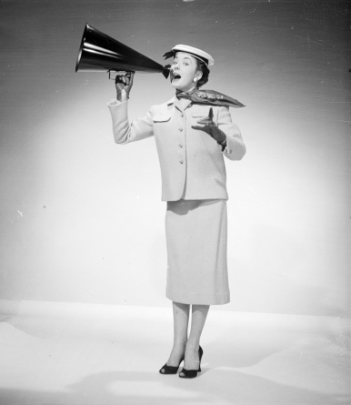

Awareness of europeana has increased…
While awareness of similar websites has remained stable.
AIDED
AWARENESS
W2
W1
Aware of europeana
Index
Wikipedia
78% | 83% | 58%
24% | 24% | 42%
17% | 18% | 43%
7% | 4% | 100%
11% | 10% | 0%
94
100
94
175
110
-5%
Google Books
0%
Google Art Project
-1%
europeana
+3%
None of these
-1%
MARKET SPECIFIC:
www.Digitaltmuseum.no
24% | 27% | 45%
12% | 14% | 30%
89
86
-3%
www.Arkivportalen.no
-2%
Q8. Which of the following websites which contain art, museum collections, digitised books and cultural history are you aware of?
Base: Norway = 502 (W2); 505 (W1)
AWARENESS, USAGE & ATTITUDES

Slide 21
Awareness of europeana has increased…
Those who are aware of europeana II WW-related events, are less aware of europeana than of alternative websites.
AIDED
AWARENESS
W2
INTEREST
AWARE OF II WW EVENTS
(High) Arts &
culture
II WW
Theme
Overall
Theme
Specific Themes
Wikipedia
78% | 76% | 85% | 57% | 64%
24% | 29% | 30% | 51% | 48%
17% | 25% | 22% | 43% | 43%
7% | 13% | 9% | 30% | 24%
11% | 8% | 0% | 0% | 0%
Google Books
Google Art Project
europeana
None of these
MARKET SPECIFIC:
www.Digitaltmuseum.no
24% | 34% | 31% | 29% | 35%
12% | 17% | 17% | 25% | 26%
www.Arkivportalen.no
Q8. Which of the following websites which contain art, museum collections, digitised books and cultural history are you aware of?
Base: Norway = 502 (W2)
AWARENESS, USAGE & ATTITUDES

Slide 22

Impact has been made with increased awareness via the internet – considerably more so than last year*
AWARENESS
SOURCE
W2
W1
17%
11%
28%
28%
5%
20%
12%
11%
5%
11%
0%
Social media
37%
The Internet
30%
A search engine
24%
Friend/colleague/acquaintance
24%
A library
24%
Conference, exhibition or event
21%
A leaflet / poster
21%
A museum
18%
Read/saw something in media
18%
Other
0%
Don’t know
3%
Q11. How did you first become aware of the europeana website?
Base: All aware of europeana in Norway n = 18 (Wave 1); 33 (Wave 2)
* NB – low base size
AWARENESS, USAGE & ATTITUDES

Slide 23



Visits to europeana have increased greatly since last year > +30%
The % of visitors among those who are very interested in II WW is on par with overall.
Website
USAGE
W2
Visited Last Month
W2 | Trend | Interested in II WW
84% | 0% | 86%
64% | 31% | 67%
50% | 9% | 55%
44% | 6% | 50%
36% | 0% | 38%
33% | -5% | 35%
www.Digitaltmuseum.no
www.Arkivportalen.no
Q9. And which have you visited in the last six months at all? Please indicate when you last visited each site.
Base: Norway, aware of website
Wikipedia n = 421 (W1) / 389 (W2); europeana n = 18 (W1) / 33 (W2); Google Books n = 124 (W1) / 123 (W2); Google Art Project n = 86 (W1) / n = 86 (W2); www.Digitaltmuseum.no n = 135 (W1) / 121 (W2); www.Arkivportalen.no n = 69 (W1) / 60 (W2)
AWARENESS, USAGE & ATTITUDES

Slide 24

europeana frequent usage in Norway is quite low, but still > 4 times to previous year
4% have visited europeana sometime during the past month (vs 1% last year).
Website
USAGE
Visited Last Month (% All Sample)
Wave 2
Wave 1
www.Digitaltmuseum.no
www.Arkivportalen.no
Q9. And which have you visited in the last six months at all? Please indicate when you last visited each site.
Base: Norway, n = 502 (W2); 505 (W1)
AWARENESS, USAGE & ATTITUDES

Slide 25
Future intended usage of europeana is high >
and slightly above last year │The % of visitors among those who are very interested in II WW is on par with overall
Future
USAGE
W2
Likely to Visit during next 6 months
W2 | Trend | Interested in II WW
96% | 1% | 97%
79% | 6% | 77%
77% | 6% | 77%
75% | 2% | 80%
74% | -1% | 76%
74% | -3% | 76%
www.Arkivportalen.no
www.Digitaltmuseum.no
Q10. And how likely are you to visit each of these sites in the next six months? Please indicate for each site.
Base: Norway, aware of website
Wikipedia n = 389 (W2) / 421 (W1) ; europeana n = 33 (W2) / 18 (W1); Google Books n = 123 (W2) / 124 (W1); Google Art Project n = 86 (W2); 86 (W1); www.Digitaltmuseum.no n = 121 (W2) / 135 (W1); www.Arkivportalen.no n = 60 (W2) / 69 (W1)
AWARENESS, USAGE & ATTITUDES

Slide 26
europeana intended frequent usage in Norway has improved to last year
5% are very likely to visit europeana during the next 6 months (vs 3% last year).
Future
USAGE
Very Likely to Use (% All Sample)
Wave 2
Wave 1
www.Digitaltmuseum.no
www.Arkivportalen.no
Q10. And how likely are you to visit each of these sites in the next six months? Please indicate for each site.
Base: Norway, n = 502 (W2); 505 (W1)
AWARENESS, USAGE & ATTITUDES

Slide 27


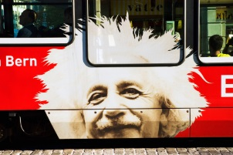
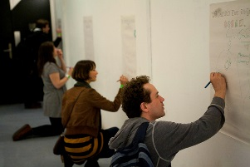

Current strengths of europeana
Top box agreement with statement (totally agree)
Wave 2
52%
europeana provides a new way to explore the things I am interested in
Wave 2
61%
Wave 2
52%
…is an authoritative source of cultural information
…. europeana is a site that I would recommend to my friends/colleagues who were interested in arts/culture
Wave 2
48%
….a site where you can access millions of books, films, paintings and museum objects
* NB – low base size
Q12. What have you heard about europeana? Please answer each statement, saying how much you agree or disagree
Base: Norway all aware of europeana. Wave 2 n = 33 (W2) 18 (W2)
AWARENESS, USAGE & ATTITUDES
26

Slide 28
80% level of agreement with europeana’s strong suits >
europeana is useful, interesting, and credible
Still, two thirds don’t find it offers something unique > they claim they can get the same information from another source
Future
USAGE
W2
Agreement | Disagreement
85% | 3%
82% | 3%
82% | 3%
70% | 18%
67% | 15%
Site with millions of books etc.
New way to explore
Authoritative source
Recommendation
Can get the same somewhere else
* NB – low base size
Q12. What have you heard about europeana? Please answer each statement, saying how much you agree or disagree
Base: Norway all aware of europeana. n = 33 (W2) 18 (W1)
AWARENESS, USAGE & ATTITUDES

Slide 29
BACKGROUND & OBJECTIVES OVERVIEW
METHOD, SAMPLE, WEIGHTING
AWARENESS, USAGE & ATTITUDES
SITE ACTIVATION
AREAS FOR IMPROVEMENT
Q & A
APPENDIX

Slide 30
Activation
Survey directs participants to the webpage of europeana…
“Please take a few minutes to take a look at the website, and then come back to this window and answer the following short questions. “
Those already aware of europeana also take part in this task.

Slide 31
Website Activation boosts Word of Mouth
> +15% more willingness to recommend europeana post-usage (vs pre) if Aware
The website’s credibility, usefulness, and interest do not increase post-activation > suggesting its appeal lies somewhere else
WEBSITE
ACTIVATION
W2
Post-Activation Agreement | Diff to Pre-Activation
85% | 15%
79% | -3%
79% | -6%
79% | N/A
79% | N/A
76% | -6%
73% | 6%
Recommendation
Authoritative source
Site with millions of books etc.
Find most things I wanted
Easy to navigate
New way to explore
Can get the same somewhere else
Q12. What have you heard about europeana?
Q13. Now that you have visited the europeana website, please take a look at the statements below. Please answer each statement, saying how much you agree or disagree.
Base: Norway all aware of europeana. n = 33 (W2)
* NB – low base size
ACTIVATION

Slide 32
Website opinion is more positive among Aware than Non-Aware
> Still, Activation has a positive impact on about half of visitors who were unfamiliar with europeana > E.g. 50% newcomers regard europeana as a new way to explore interesting things, 45% find it credible, and 45% find it a useful resource.
WEBSITE
ACTIVATION
W2
Slightly Agree
Totally Agree
Post-Activation Agreement | Don't know
85% | 0%
40% | 15%
Recommendation
Authoritative source
Site with millions of books etc.
Find most things I wanted
Easy to navigate
New way to explore
Can get the same somewhere else
Aware
Not aware
Aware
79% | 3%
45% | 19%
Not aware
Aware
79% | 0%
45% | 23%
Not aware
Aware
79% | 3%
34% | 19%
Not aware
Aware
79% | 0%
41% | 12%
Not aware
Aware
76% | 0%
50% | 13%
Not aware
Aware
73% | 6%
32% | 25%
Not aware
Q12. What have you heard about europeana?
Q13. Now that you have visited the europeana website, please take a look at the statements below. Please answer each statement, saying how much you agree or disagree.
Base: Norway. n = 33 (aware of europeana) n = 469 (not aware of europeana)
ACTIVATION

Slide 33
Website Activation triggers 60% willingness to (re)visit
All of those who are already aware of europeana and (almost) all who are aware of its WW II related events, are likely to use again europeana. The majority of those who are interested in arts/culture and WWII ‘follow suit’.
CURRENT USAGE
W2
6% P6M
P6M = Past 6 months
Base: Total sample W2
Index
167
133
199
152
AWARE
NOT AWARE
VERY INTERESTED
QUITE INTERESTED
INTERESTED
NOT INTERESTED
AWARE
NOT AWARE
TOTAL
europeana
Arts/culture
WW II Overall Theme
WW II Overall events
Q14. How likely are you to visit this site again in the future?
Base: Norway, total n = 502; 33 (aware of europeana) n = 469 (not aware of europeana), 154 (very interested in arts/culture), 348 (quite interested in arts/culture), 334 (interested on WWII Overall Theme), 115 (not interested on WWII Overall Theme), 75 (aware of WWII Overall europeana events), 375 (not aware of of WWII Overall europeana events)
ACTIVATION

Slide 34
BACKGROUND & OBJECTIVES OVERVIEW
METHOD, SAMPLE, WEIGHTING
AWARENESS, USAGE & ATTITUDES
SITE ACTIVATION
AREAS FOR IMPROVEMENT
Q & A
APPENDIX

Slide 35

What they like about europeana…
#1
Interesting and useful
“Exciting page I've never heard of before. It has many articles on topics I find interesting.”
#2
I want to learn more!
“I want to see more of the website and find out what it can offer me.”
#3
It has substance
“It has a good number of articles I want to read and know more about.”
#4
Exciting
“Awesome website!”
Diverse and thorough
“This is a webpage where one can find lots of information.”
#5
AREAS FOR IMPROVEMENT

Slide 36
What they don’t like about europeana…
#1
It’s not for me
“My cultural interests are mainly about music and music events.”
#2
Lack of focus
“I did not understand it. I was hard to find out what existed on the page.”
#3
Hard to find your way
“At the homepage it is not clear what is the purpose of the website, or how to use it. It looks messy.”
#4
Language is a barrier
“When selecting Norwegian, I didn’t find nothing else than the headlines in that language. Other than that, it was a bit messy.”
There are other ways…
“I prefer to go to museums.”
#5
AREAS FOR IMPROVEMENT

Slide 37

ENCOURAGING
USAGE/IMPROVEMENTS
1
Navigation (7%)
Intuitive & simple
2
Language (5%)
Extend / complete translation
3
Design (3%)
Visually sell yourself
4
More content (2%)
Add topics of interest
5
Home-page (2%)
Improve functionality

Slide 38
Advocacy barometer
* 6% say they don’t know
None whatsoever
Totally Agree
Slightly Agree
Neutral
Slightly disagree
Totally disagree
Advocates
Indifferent
Opponents
70% (55%)
6% (15%)
18% (23%)
(Figures in brackets refer to wave 1 scores for Norway)
Q13. europeana is a site that I would recommend to my friends/colleagues who were interested in arts/culture.
Base: Norway all aware of europeana. n = 33 (W2) 18 (W1)
AREAS FOR IMPROVEMENT

Slide 39
Advocacy barometer score
Overall Trend
A good increase of 19 points to last year
W2
Barometer Score = Advocates - Opponents
+51
Advocates
Opponents
+100
+32
0
-100
W1
Q13. europeana is a site that I would recommend to my friends/colleagues who were interested in arts/culture.
Base: Norway all aware of europeana. n = 33 (W2) 18 (W1)
AREAS FOR IMPROVEMENT

Slide 40
Advocacy barometer score
II WW-related events interest / awareness trend
II WW Interest and Awareness increase barometer scores by 19, and 9 points, respectively.
Interest in II WW theme
Increase of 19 points
Barometer Score = Advocates - Opponents
+53
Interested
+34
Not interested
Advocates
Opponents
+55
+100
+46
0
-100
Aware
Not Aware
Awareness of II WW overall theme events
Increase of 9 points
Q13. europeana is a site that I would recommend to my friends/colleagues who were interested in arts/culture.
Base: Norway all aware of europeana. n = 33 (W2)
AREAS FOR IMPROVEMENT

Slide 41
Bringing it all together
Only 9% of all respondents were aware of europeana at Wave One
12%
Italy
4%
Norway
6%
Poland
AWARENESS, USAGE & ATTITUDES

Slide 42
Bringing it all together
Awareness across all markets has increased by one third from 9% to 12%
12%
Italy
10%
Italy (W2)
4%
Norway
7%
Norway (W2)
6%
Poland
14%
Poland (W2)
AWARENESS, USAGE & ATTITUDES

Slide 43
BACKGROUND & OBJECTIVES OVERVIEW
METHOD, SAMPLE, WEIGHTING
AWARENESS, USAGE & ATTITUDES
SITE ACTIVATION
AREAS FOR IMPROVEMENT
Q & A
APPENDIX

Slide 44
BACKGROUND & OBJECTIVES OVERVIEW
METHOD, SAMPLE, WEIGHTING
AWARENESS, USAGE & ATTITUDES
SITE ACTIVATION
AREAS FOR IMPROVEMENT
Q & A
APPENDIX

